Slide 1
The radio star lives
MTV hasn’t killed it yet…

Slide 2
Intercepting, modifying, and generating wireless signals with SDR
DEFCON talk by Caleb Madrigal
calebmadrigal.com

Slide 3


What was it?
Using a Software Defined Radio (SDR) to control the airwaves
01
Radio waves === The Force
02
Networking at the Physical layer
03
He unlocked his Jeep with a replay attack.
04
Notes:
SDR like the HackRF allows programmable control over the hardware, controlling frequencies from 1MHz to 6GHz
Radiowaves can flow through our bodies, ever notice how the radio plays better when you have your hand on the antenna?
Dealing with teeny tiny bits, 1s and 0s, fascinating stuff

Slide 4
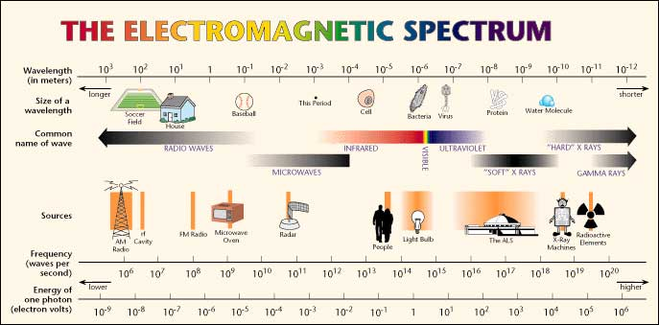
Where are we looking?

Slide 5
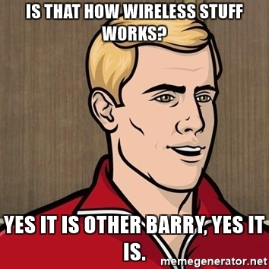

Slide 6
What is wireless?
"Radio" (AM, FM)
TV
Cell phones - 800MHz &1900MHz
Wifi - 2.5MHz
Bluetooth - 2483.5 MHz
GPS - 1575.42MHz & 1227.60MHz
Wireless security systems - 2.4MHz (WIFI)
Any form of Wireless IoT device – 2.4MHz (WIFI)
SCADA systems / large industrial equipment
Car Key Fobs -- 315 MHz
ALL USE RADIOWAVES!
Propagation Animation
from Caleb’s slides

Slide 7

What is wireless?
"Radio" (AM, FM)
TV
Cell phones
Wifi
Bluetooth
GPS
Wireless security systems
Any form of Wireless IoT device
SCADA systems / large industrial equipment
ALL USE RADIOWAVES!
from Caleb’s slides

Slide 8
Who uses the radio?

Slide 10
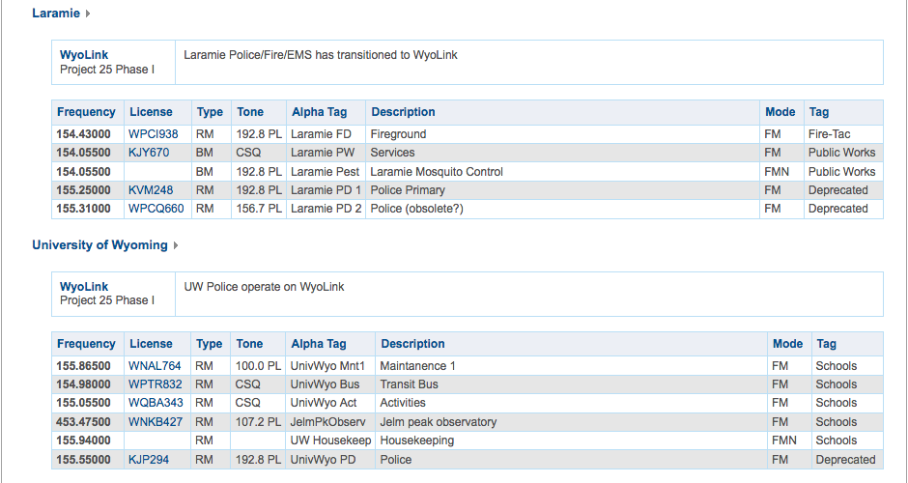

Slide 12
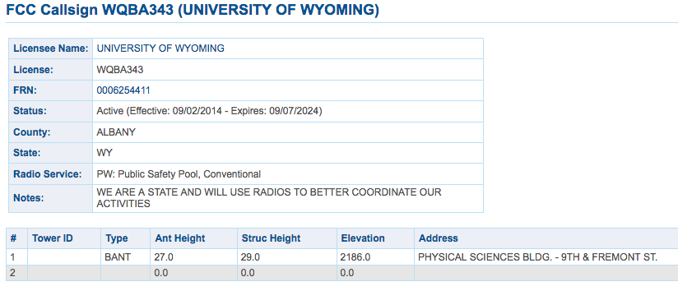
UW Activities
radioreference.com

Slide 13
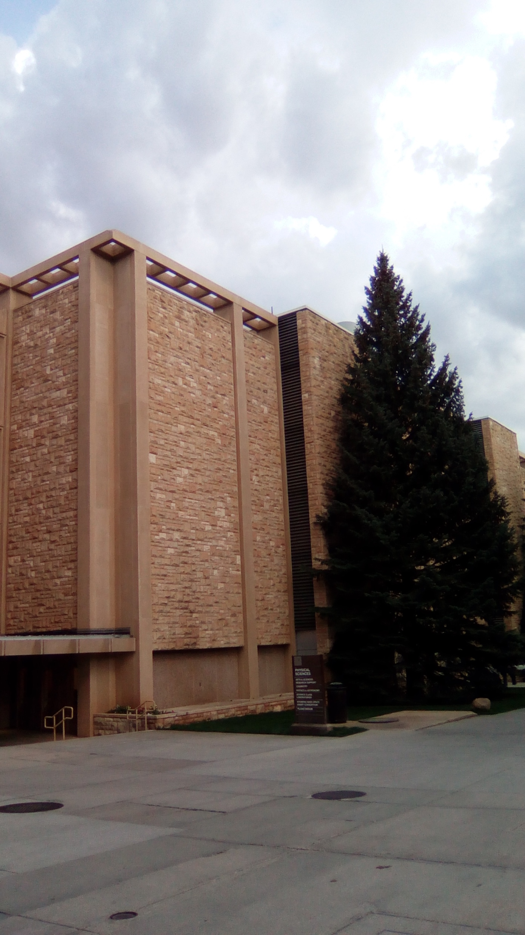
UW Activities
radioreference.com

Slide 14
UW Activities
radioreference.com

Slide 15
UW Activities
radioreference.com

Slide 16
Scare factor
Many radio wave communications in public frequency bands
Unencrypted over those^^
When did people get so smart?
Anyone can pick them up (legally)
Security through obfuscation
Is counting on the ignorance of others safe?
Notes:
Don’t need a license to TX/RX in public airspace – only need the right tools
What the heck? – a change in medium shouldn’t be relied on as security
Didn’t expect hackers to get their hands on software radios

Slide 17
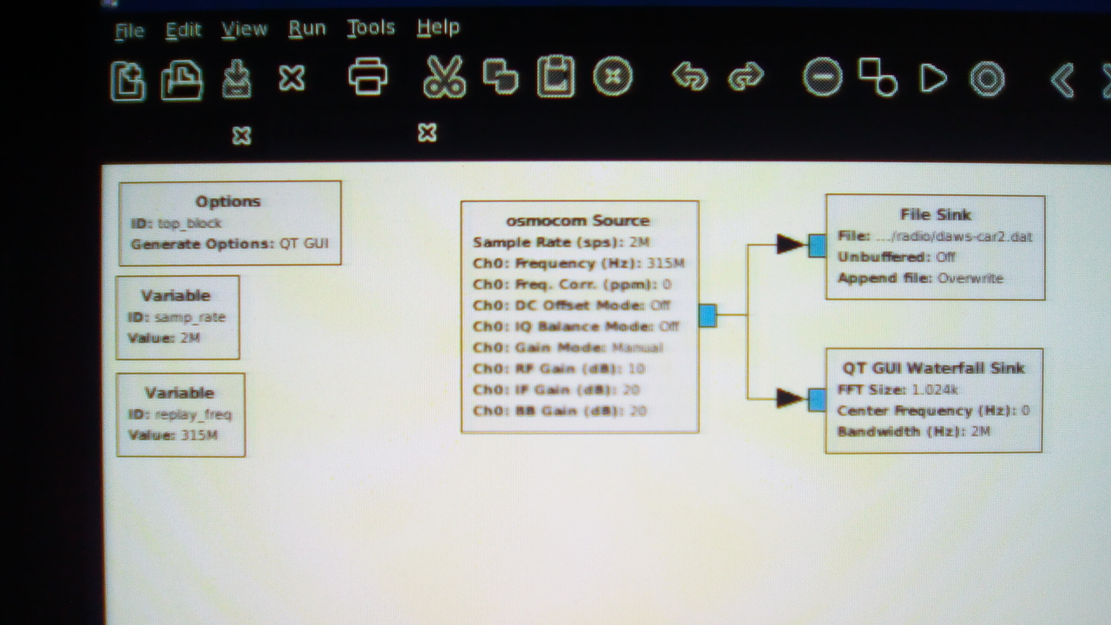
So I gave it a shot

Slide 18
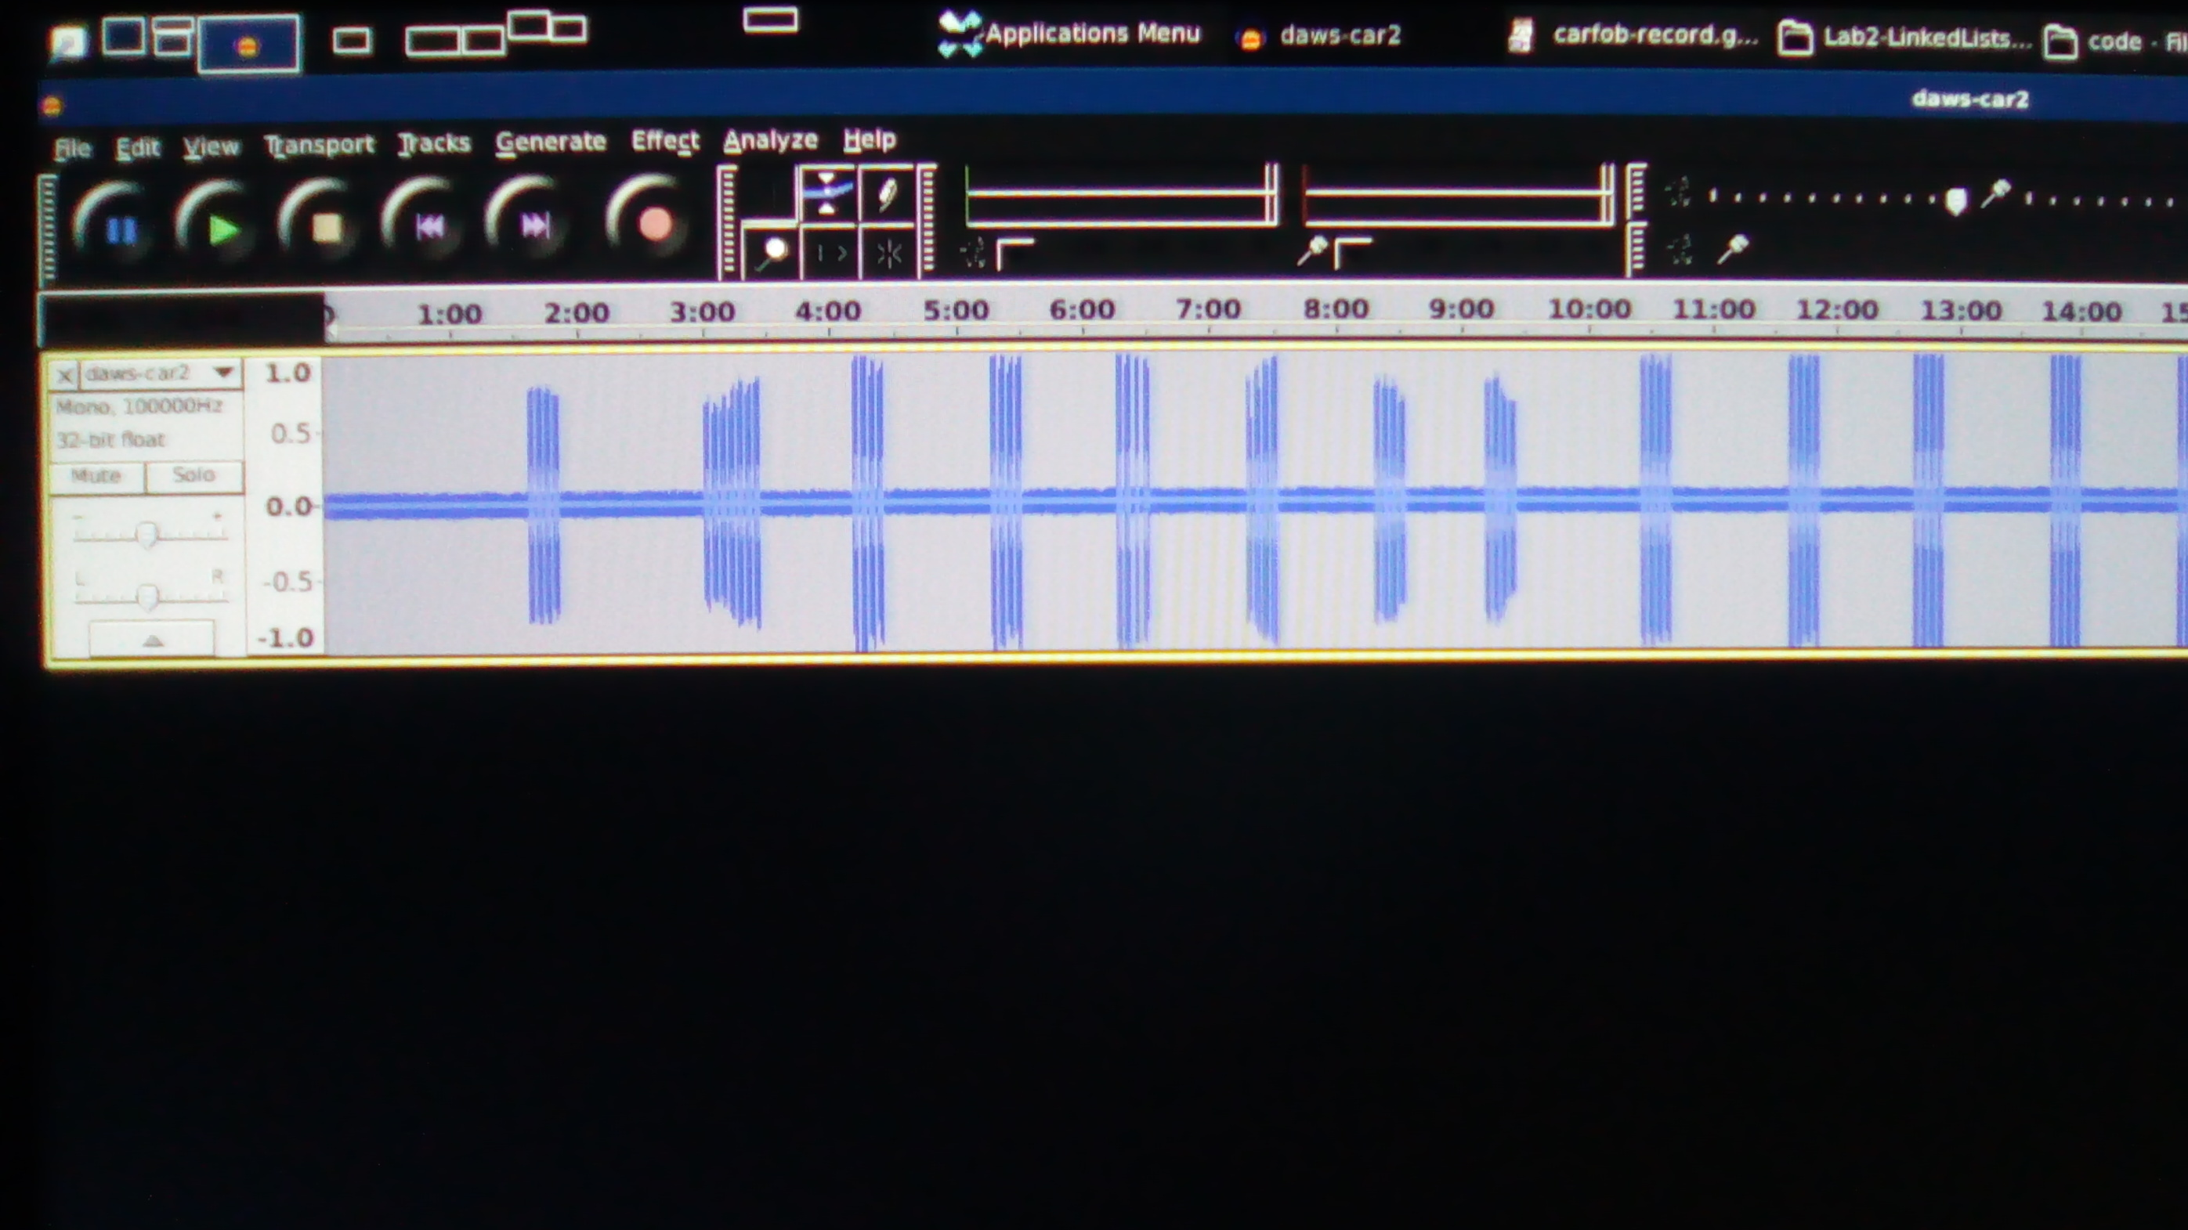

The audacity

Slide 19
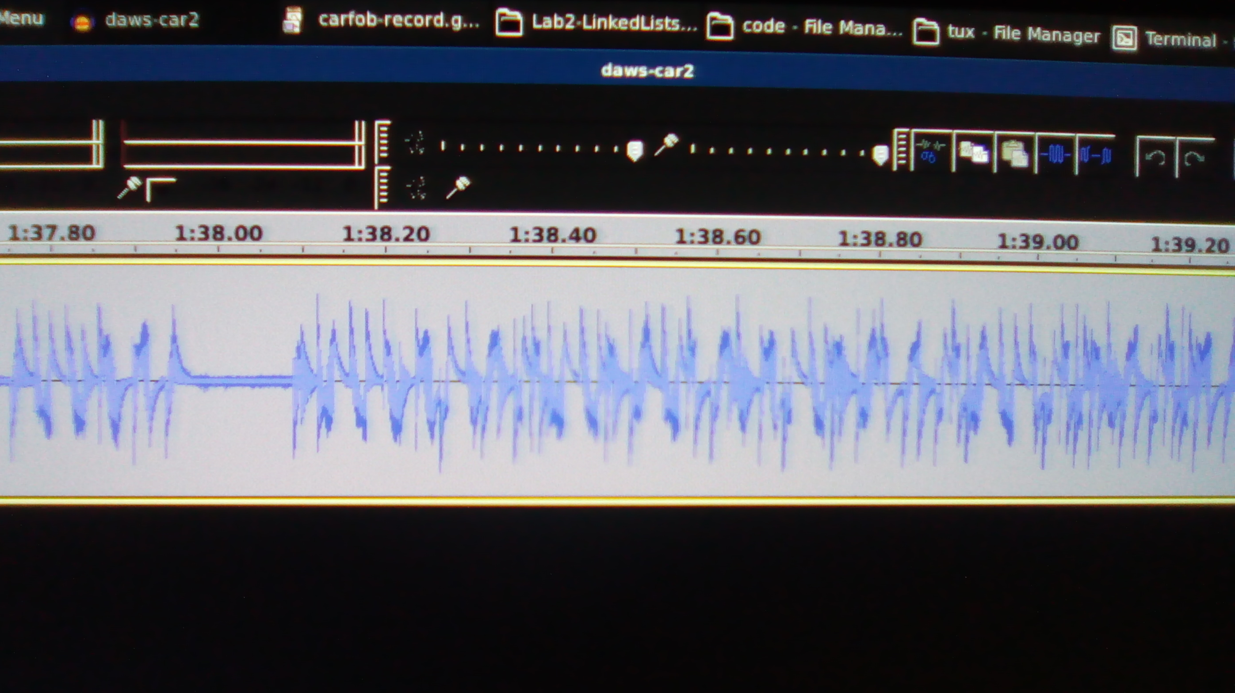
The audacity

Slide 20

The audacity

Slide 21
Down the rabbit hole
Don’t be late for tea!

Slide 22
Cognitive radio networks
Automagically detect uninhabited frequencies
Starts transmitting there
123rf.com

Slide 23
Which is kind of like

Slide 24
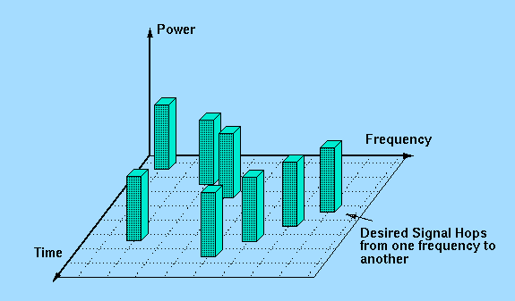
Frequency hopping Spread spectrum
Frequency Hopping “Across The” Spectrum
wirelesscommunication.nl
Notes:
Transmission security topic
Hop frequency based on sequence generated by crypto funct known by TX & RX

Slide 25
Which is kind of like

Slide 26
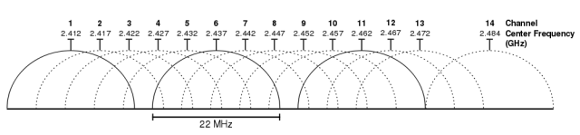
WiFi’s 3 channel system
Choose the best frequency for you!
https://www.extremetech.com/computing/179344-how-to-boost-your-wifi-speed-by-choosing-the-right-channel
Notes:
Transmission security topic
Hop frequency based on sequence generated by crypto funct known by TX & RX

Slide 27
WiFi’s 3 channel system
Choose the best frequency for you!
https://www.extremetech.com/computing/179344-how-to-boost-your-wifi-speed-by-choosing-the-right-channel

Slide 28
resources
Airflight radio surveillance
Beginners Guide to Antennas
Radio Frequency DB
National Association for Amateur Radio
Radio Hacker Extraordinare from Defcon Talk

